Slide 1
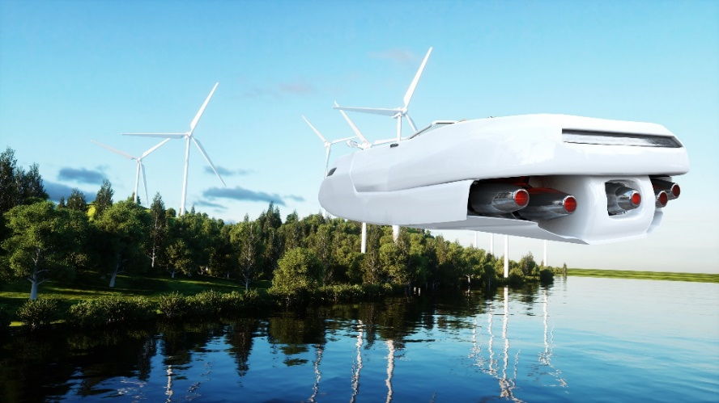
Modern HTML
The New HTML5 Elements
The New <time> Element
The <video> Element

Slide 2
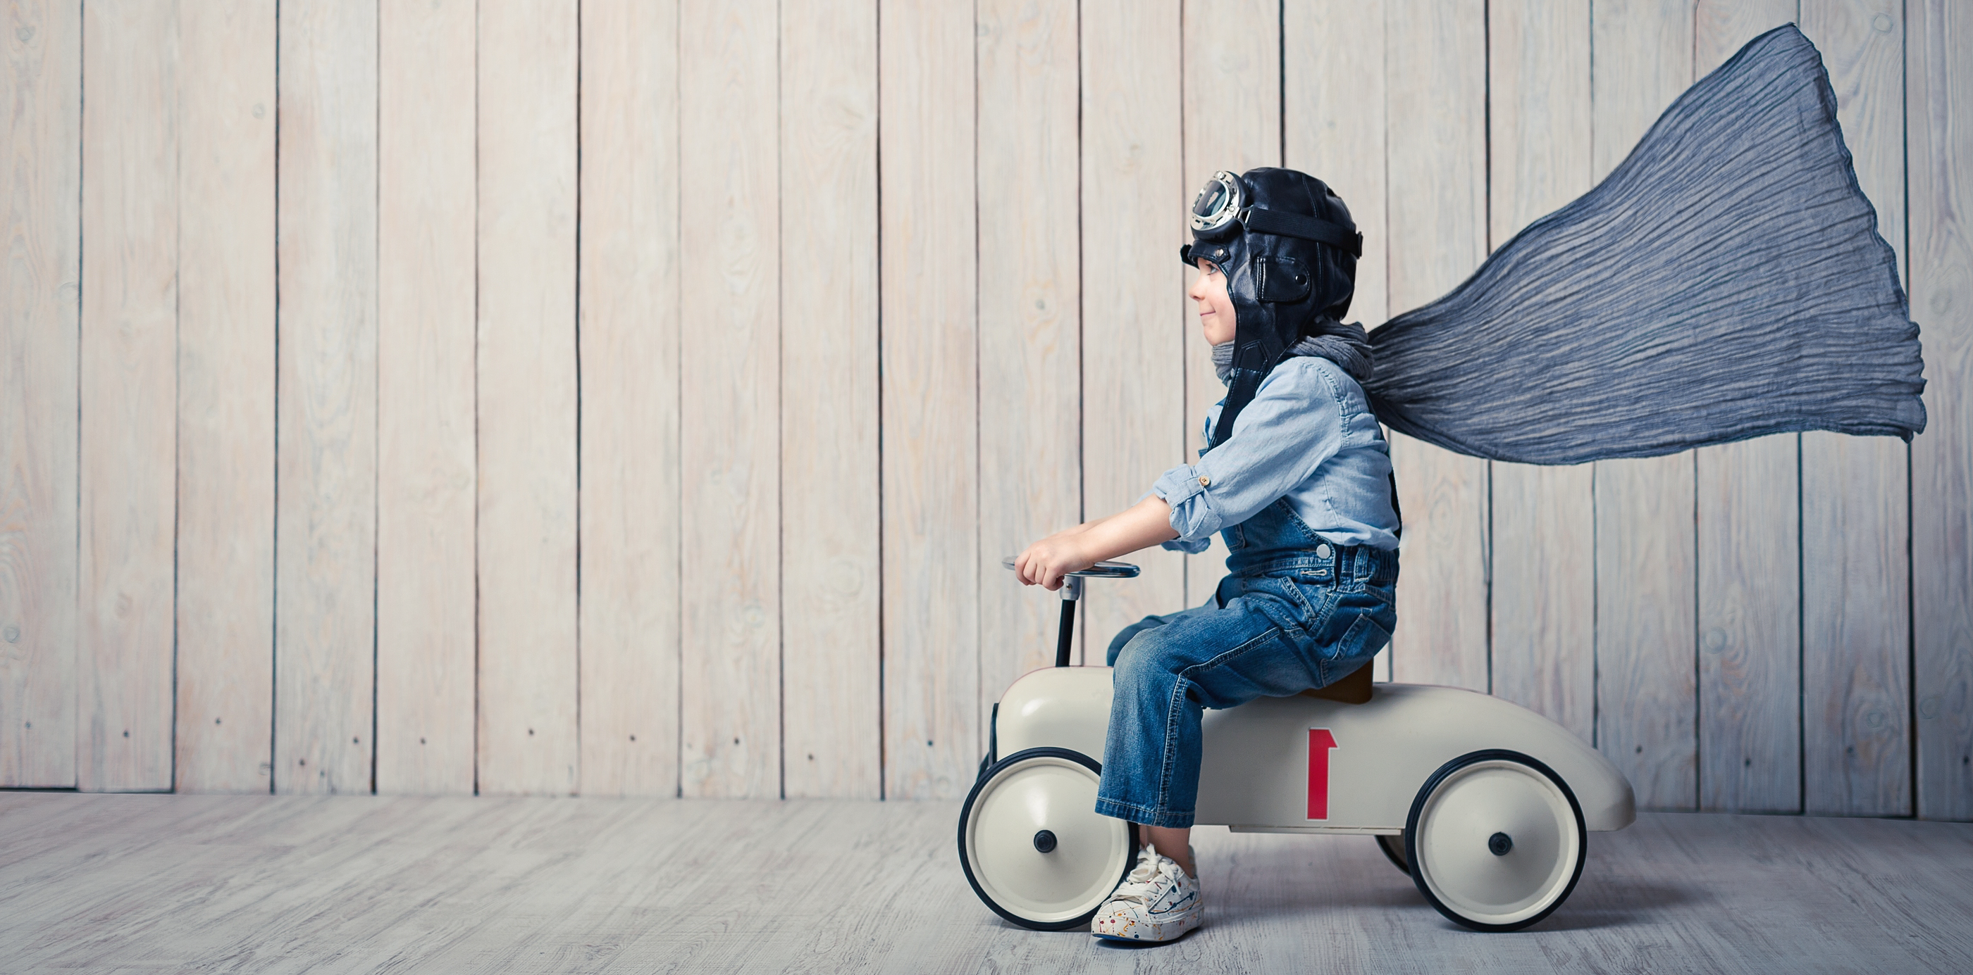
See Also
https://www.youtube.com/watch?v=hY7QCiY8Rz4
https://www.w3schools.com/html/html5_video.asp
https://www.w3schools.com/html/html5_new_elements.asp

Slide 3
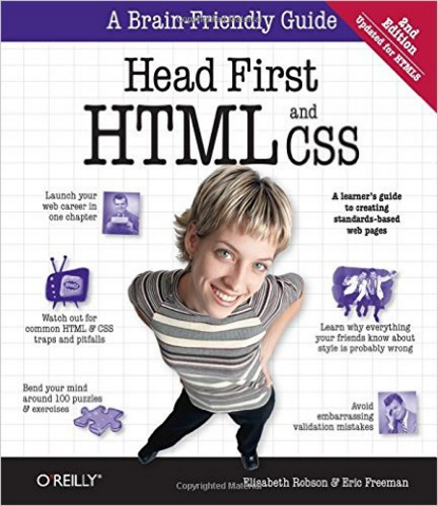
In the Book
Chapter 12:
Modern HTML

Slide 4
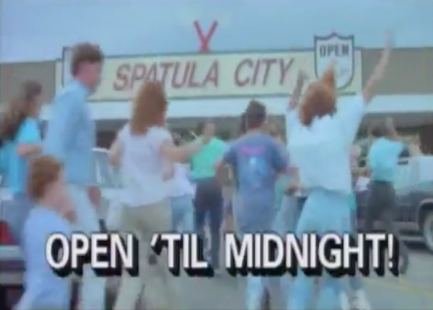

Spatula City (Blog)
UHF (1989)
‘Weird Al’ Yankovic
Header
<body>
<div id="header">Header</div>
<div id="navigation">Navigation</div>
<div id="products">Products</div>
<div id="blog">Main</div>
<div id="directions">Sidebar</div>
<div id="footer">Footer</div>
</body>
blog.html
Navigation
Products
Specials
Blog Entries
Footer
Notes:
We are designing a modern web site for Spatula City. Explain Spatula City.
There are several pages. But we are going to focus on the “blog” page where the CEO adds updates about Spatula City – news, celebrities, etc.
We are going to give a nice three column look.
#1 Header and footer at the top and bottom
#2 We are going to add a navigation area … links to quickly get around the entire site.
#3 Links to products on the left and “specials” on the right. These are all common to all the pages.
#4 Blog entries in the middle. The main content. Expands to fill width.
#5 No surprises in the HTML. We’ll create separate <div>s for the pieces. That’ll make it easy to copy them among all the pages. It’ll make it easy to style them by piece in the CSS.

Slide 5
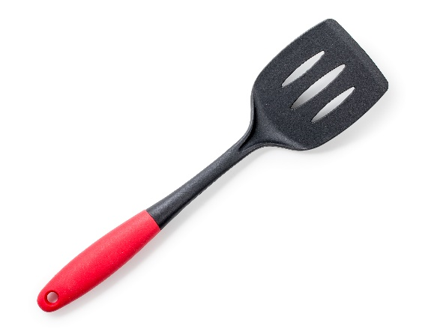
New Elements in HTML5
Header
<body>
<header>Header</header>
<nav>Navigation</nav>
<section id="products">Products</section>
<section id="blog">Main</section>
<aside>Sidebar</aside>
<footer>Footer</footer>
</body>
Navigation
Products
Specials
Blog Entries
Footer
Notes:
But this is a modern site. We want to use all the power of HTML5.
HTML5 has some new tags we can use to identify.
“products” and “specials” … very specific to our site. More generic “section”.
Could use a “section” for special, but HTML5 provides an “aside” tag to say this is a section, but really low importance. In a pinch (we’ll see shortly) we could drop that from the screen … or move it to the bottom.

Slide 6
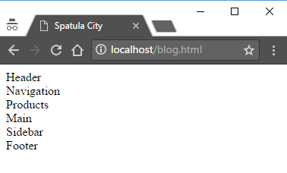


New Elements in HTML5
These are just <div> elements
You still have to style them
<body>
<header>Header</header>
<nav>Navigation</nav>
<section id="products">Products</section>
<section id="blog">Main</section>
<aside>Sidebar</aside>
<footer>Footer</footer>
</body>
Notes:
And what does it look like with these new elements?
#1 exactly the same as if you had used divs

Slide 7
Descriptive Content
Browsers can handle content in special ways.
It might be especially useful on smaller devices.
It helps the search engines.
Even if it does nothing – you are no worse off!
It makes your HTML/CSS easier to read (and write).
<body>
<header>Header</header>
<nav>Navigation</nav>
<section id="products">Products</section>
<section id="blog">Main</section>
<aside>Sidebar</aside>
<footer>Footer</footer>
</body>
I have built-in support for navigation
This isn’t so important. I can move it to the bottom.

Slide 8
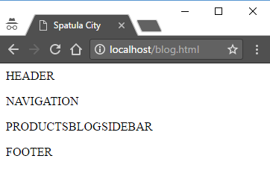
Table Layout (step 1)
spatcity.css
#main {
display:table;
}
#mainRow {
display: table-row;
}
section {
display: table-cell;
}
aside {
display: table-cell;
}
blog.html
<body>
<header>Header</header>
<nav>Navigation</nav>
<div id="main">
<div id="mainRow">
<section id="products">Products</section>
<section id="blog">Main</section>
<aside>Sidebar</aside>
</div>
</div>
<footer>Footer</footer>
</body>

Slide 9
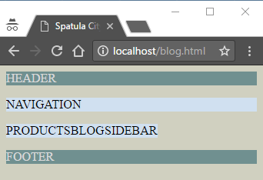

Colors (step 2)
spatcity.css
body {
background-color: #d0d0c0;
}
header {
background-color: #709090;
color: #d9d9d9;
}
footer {
background-color: #709090;
color: #d9d9d9;
}
nav, section, aside {
background-color: #d0e0f0;
}
Notes:
Could have used a common rule for coloring the header and footer. Can have multiple “header” rules. Is it better to keep concepts together and spread out the rules? Or is it better to keep the rules condensed and spread the concepts out among them?
Very much like programming. And like programming you will find yourself refactoring and changing as time goes on. The real question is how your site will evolve with time.
Same crystal ball image I use for this very some discussion in programming classes (Java, C++, JavaScript).

Slide 10
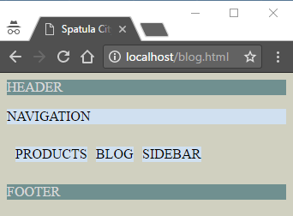
Spacing (step 3)
#main {
border-spacing: 10px;
}
I want all gaps to be the same
Too much between header and navigation
Too much around table
Too much after footer
I want BLOG to spread out

Slide 11
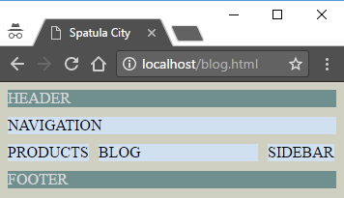
Spacing (step 3)
#main {
...
border-spacing: 10px;
margin-left: -10px;
margin-right: -8px;
}
section#products {
width:225px;
}
section#blog {
width: 100%;
}
aside {
...
width:250px;
}
header {
...
margin-bottom: 10px;
}
footer p, header p, nav p {
margin-top: 0px;
margin-bottom: 0px;
}

Slide 12
Blog Content (step 4)
<section id="blog">
<article>
<header>
<h1>As Seen in the Movies!</h1>
<p>1/10/1989</p>
</header>
<p>Julie said ... </p>
</article>
<article>
<header>
<h1>An Electronic Spatula?</h1>
<p>10/18/1985</p>
</header>
<p>Some ... </p>
</article>
</section>
<section id="blog">
<h1>As Seen in the Movies!</h1>
<p>1/10/1989</p>
<p>Julie said ... </p>
<h1>An Electronic Spatula?</h1>
<p>10/18/1985</p>
<p>Some ... </p>
</section>
Entry
Header

Slide 13
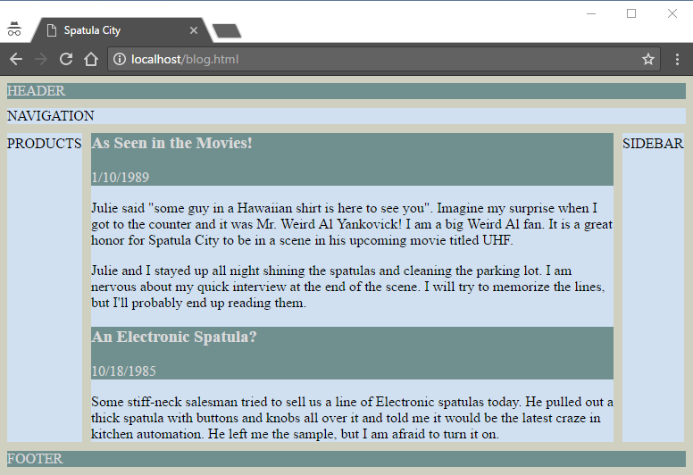
Blog Content (step 4)
Common
<header> in CSS

Slide 14
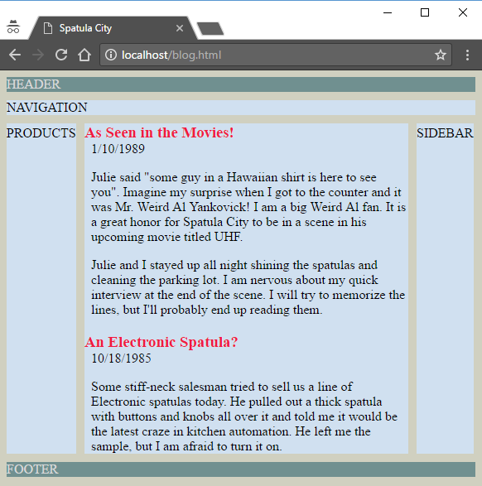
Blog Content (step 4)
blog.html
<header id="top"><p>HEADER</p></header>
spatcity.css
header#top {
...
}
article header h1 {
color: #F01941;
margin-bottom: 0px;
}
article p {
padding-left:8px;
}

Slide 15
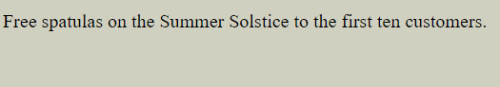
The <time> Element
Free spatulas on the
<time title="Tuesday, June 20, 2017 at 11:24PM CDT" datetime="2017-06-21 04:24Z">Summer Solstice</time>
to the first ten customers.
UTC Timezone
(also called GMT)
(also called Zulu)
datetime="2017"
datetime="04:24"
datetime="2017-06-21"

Slide 16
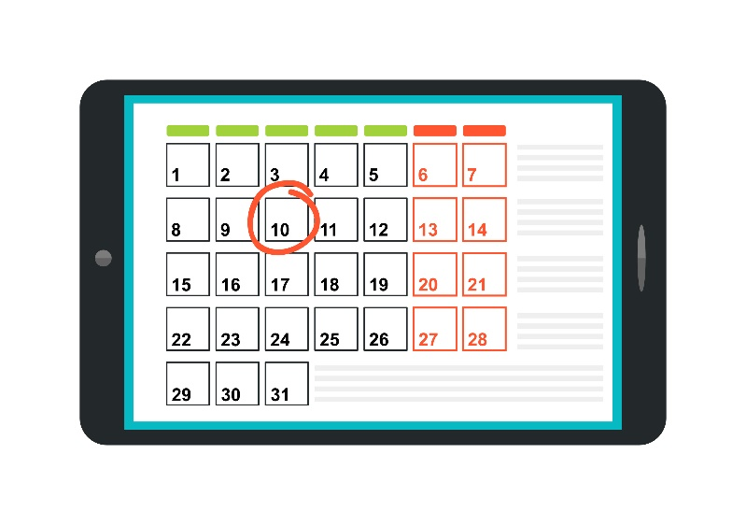
The <time> Element
Datetime is for the browser and/or your JavaScript to read.
Maybe automatically adding event to your schedule app?
Maybe displayed in a calendar control?
Even if it is never used, you are no worse off!
Makes your HTML/CSS easier to read?

Slide 17
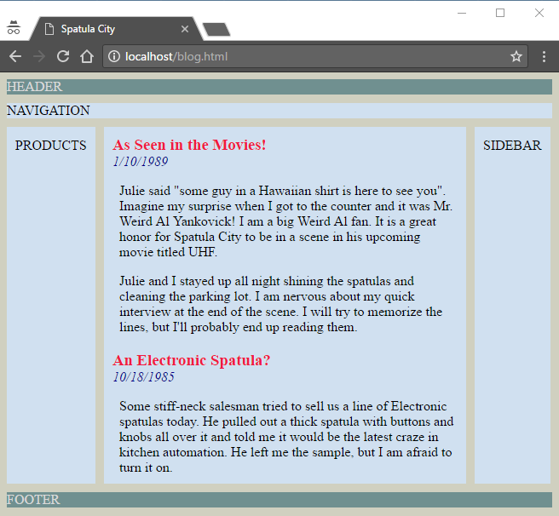
Time and Spacing (step 5)
<time datetime="1989-01-10">1/10/1989</time>
<time datetime="1985-10-18">10/18/1985</time>
section {
...
padding: 10px;
}
aside {
...
padding: 10px;
}
article header time {
font-style: italic;
color: darkblue;
}

Slide 18
The <video> Element
<video
controls
autoplay
loop
width="640" height="480"
src="video/myVid.mp4"
poster="images/myVidPoster.png">
<p>Could not play video.</p>
</video>
Show player controls
Automatically start when page loads
Start over when done
Size of player (in the page)
Video file (multiple src allowed)
Image to show when not playing
Content to show if the browser doesn’t support the video.
Could be flash, could be an image or text or anything.

Slide 19
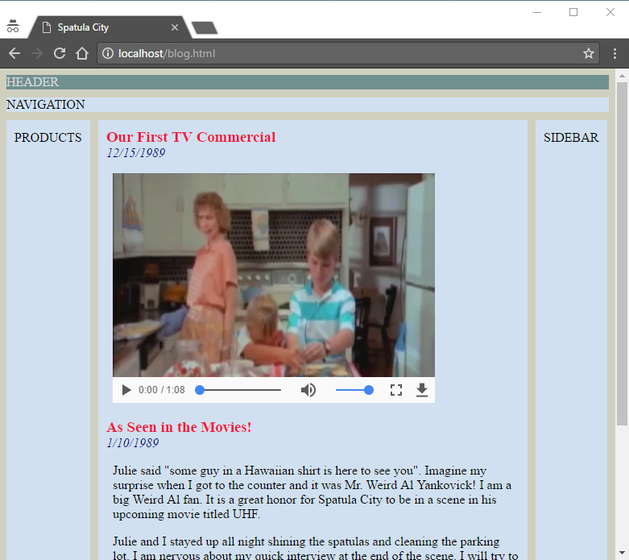
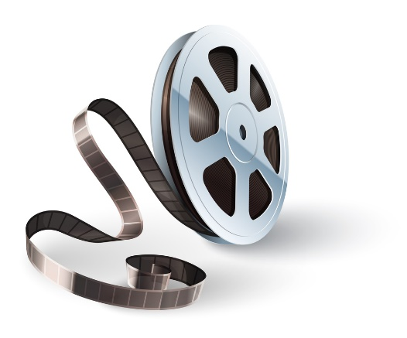
Video (step 6)
<article>
<header>
<h1>Our First TV Commercial</h1>
<time datetime="1989-12-15">12/15/1989</time>
</header>
<p>
<video width="400" controls>
<source src="video/spatula.mp4">
</video>
</p>
</article>

Slide 20
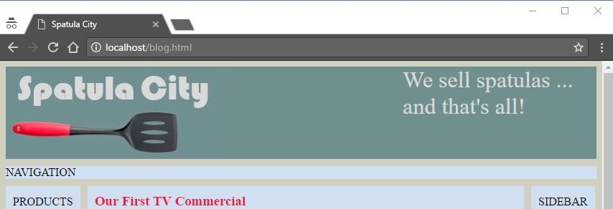
Header and Footer (step 7)
<header id="top">
<img src="images/spatlogo.jpg">
<div id="statement">
<p>We sell spatulas ...</p>
</div>
</header>
<footer>
<p>&copy;1989 Spatula City<br>
All trademarks ...<p>
</footer>
#statement {
font-size: 2em;
float:right;
width:250px;
padding-right:20px;
}
footer {
text-align: center;
...
}

Slide 21
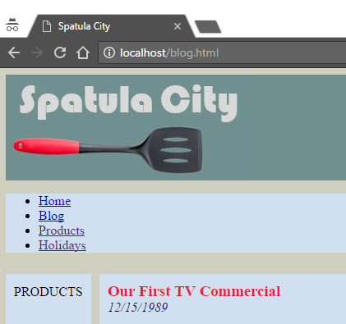
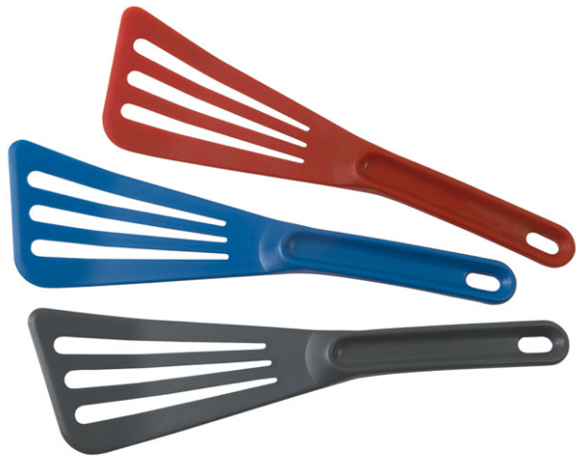
Navigation (step 8)
<nav>
<ul>
<li><a href="index.html">Home</a></li>
<li class="selected"><a href="blog.html">Blog</a></li>
<li><a href="">Products</a></li>
<li><a href="">Holidays</a></li>
</ul>
</nav>

Slide 22
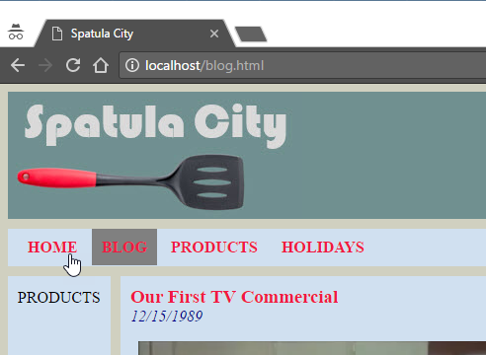
Navigation (step 8)
<nav>
<ul>
<li><a href="index.html">Home</a></li>
<li class="selected"><a href="blog.html">Blog</a></li>
<li><a href="">Products</a></li>
<li><a href="">Holidays</a></li>
</ul>
</nav>
ul {
list-style-type: none;
padding:10px;
margin:0px;
}
ul li {
display: inline;
padding: 10px;
}
ul li.selected {
background-color: #808080;
}
ul li a:link, ul li a:visited {
color: #F01941;
text-decoration: none;
font-weight:bold;
text-transform:uppercase;
}

Slide 23
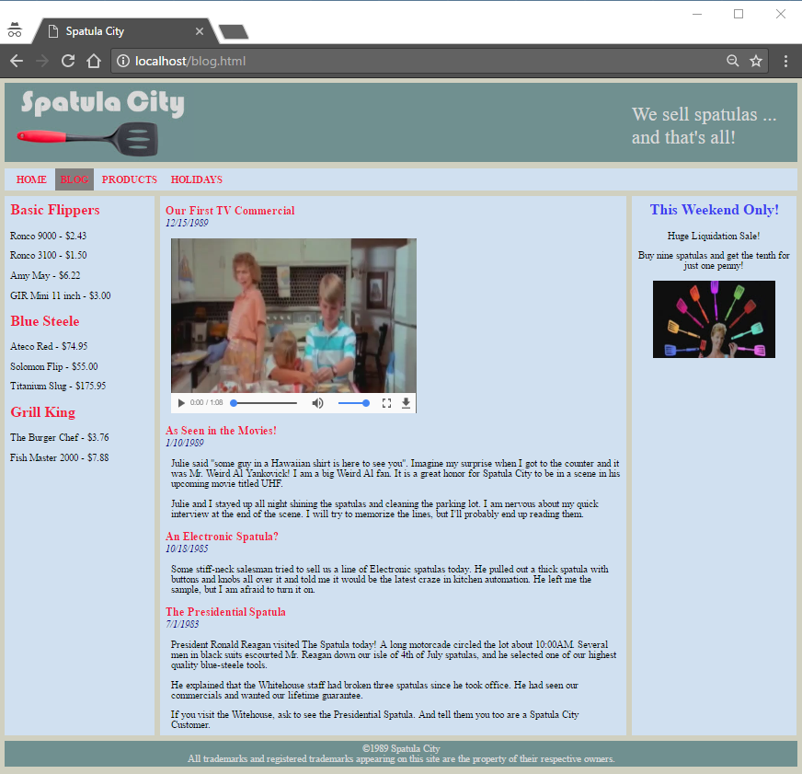
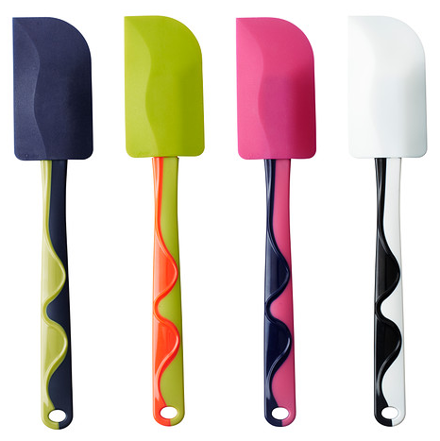
Final Content

Slide 24

Tinkering
Find a Youtube video on “how to use a spatula”. Add a blog entry with the video.
Replace the sidebar image with “special.gif”, which is an animated GIF pulled from the commercial.

